Slide 1
Anomaly based intrusion detection system
Presentation [Internal Evaluation]
Group ID: BSCS-F17-019
Group members:
Muhammad Hamza Aziz(041)
Hamza Ahmed(027)

Slide 2
Abstract
Computer Security
Government agencies
Industries
Big commercialized infrastructures
Signature Based Intrusion Detection System
Detect novel attacks based on pattern
Anomaly based Intrusion Detection System
Detect strange attacks based on statistics
NSL-KDD + UNSW NB-15

Slide 3
introduction
An Intrusion Detection System is employed to differentiate every kind of nasty link traffic and laptop usage that cannot be identified traditional firewall.
IDS classification is done in many ways.
Network Intrusion Detection System acknowledge intrusions by investigating network traffics data and inspecting hosts data.
Host-based Intrusion Detection System involves the working of an agent on a host machine which distinguishes intrusions by inspecting system calls, application log files, file-system variations
Hybrid Intrusion Detection System syndicates one or more methods. Host data is united with network info to create a comprehensive view of the system.

Slide 4
introduction
Recognition is done by two ways:
Signature Based Detection method is specifically used for known patterns/novel attacks to detect nasty code.
Anomaly Based Detection methods are designed to distinguish abnormal behavior in the system to normal behavior.
These specific patterns are termed as signatures.
The ordinary usage is base lined, and signals/messages are created when someone diverges from the standard behavior.

Slide 5
Why IDS important….?
Confidentiality is the main concern from individual to corporate sector.
Sony Studio’s Data Breach
Dawn of cloud computing world
Industrial thinktanks guesstimate that almost 60,000 new, nasty computer programs and 315,000 new, nasty files are discovered daily.
From 2006 to 2012, the number of security happenings stated by federal agencies amplified from 5,503 to 48,562 – a rise of 78.2%.
In 2013 McAfee investigation estimated that worldwide cybercrime failures might total $400 billions.

Slide 6
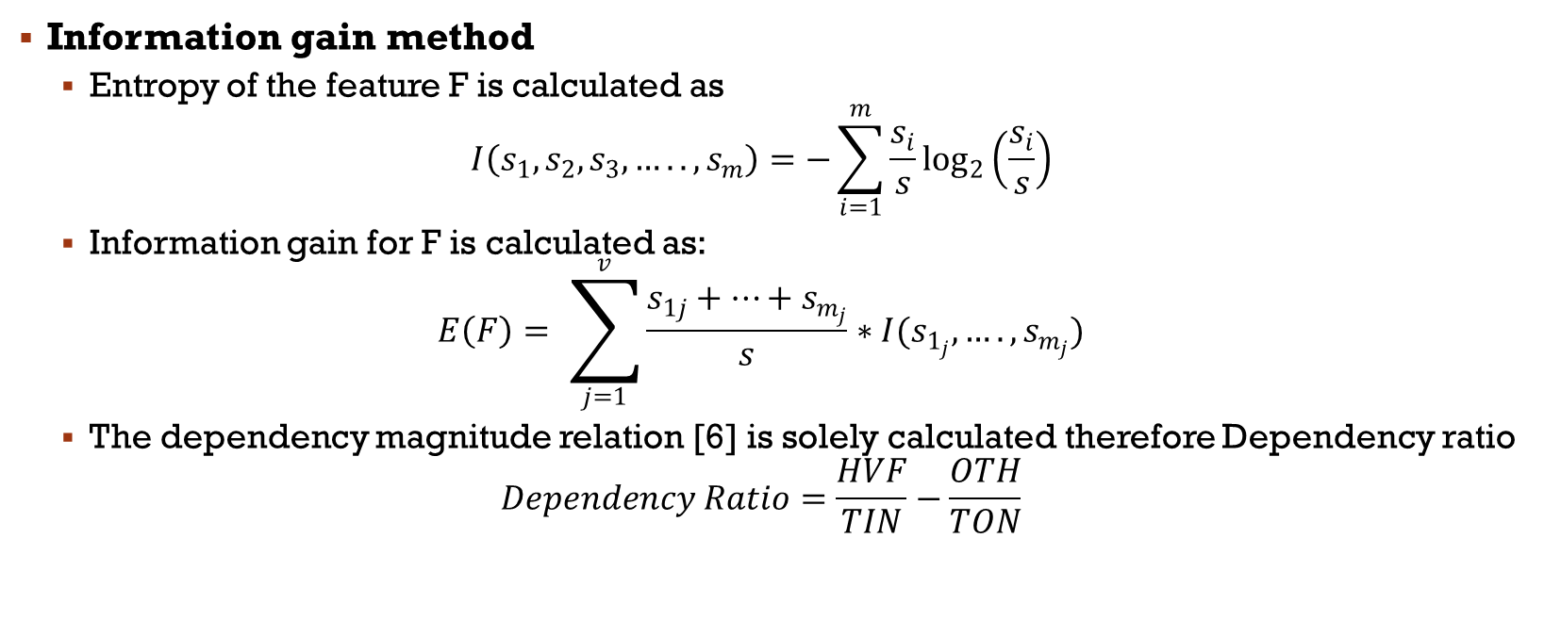
Literature review
Information gain method
Entropy of the feature F is calculated as
$$I\left(s_{1},s_{2},s_{3},…..,s_{m}\right)=−\sum_{i=1}^{m}{\frac{s_{i}}{s}\log_{2}\left(\frac{s_{i}}{s}\right)}$$
Information gain for F is calculated as:
$$E\left(F\right)= \sum_{j=1}^{v}{\frac{s_{1j}+⋯+s_{m_{j}}}{s}}∗I(s_{1_{j}},….,s_{m_{j}})$$
The dependency magnitude relation [6] is solely calculated therefore Dependency ratio
$$Dependency Ratio=\frac{HVF}{TIN}−\frac{OTH}{TON}$$

Slide 7
Literature review
Rule induction is one in all the chief varieties of data processing and is probably the foremost common variety of information discovery in unsupervised learning systems.
For the how much the rule to be helpful there must be two things that provide a great information
Accuracy – however typically is that the rule corrects?
Coverage – however typically will the rule apply?

Slide 8
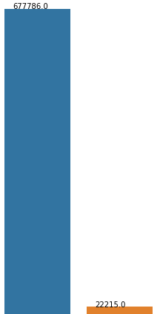
UNSW NB-15
DataSet | No of records
UNSW-NB15_1.csv | 700001
Record for 0 category
Record for 1 catagory

Slide 9
Features of UnSW NB-15

Slide 10
Features of UnSW NB-15

Slide 11
Features of UnSW NB-15

Slide 12
Features of UnSW NB-15

Slide 13
Working of Anomaly Based Intrusion Detection System:
Anomaly based detection involves following steps:
Pre-processing
Feature Selection
Parameter optimization
Classification
Evaluation

Slide 14
Pre-processing
Important step in data mining
Convert the raw into understandable format.
Label Encoding and OneHotEncoding
UNSW NB-15 contains 49 features.
UNSW NB-15 now has 205 features.

Slide 15
Feature selection
In machine learning it is a procedure of choosing a subset of pertinent features/attributes used to create model.
For specific results we need relevant features.
Feature selection methods are adopted for following motives
Oversimplification of model so it become easy to understand.
Shorter training time.
To avoid curse of dimensionality.
Enhance generalization by reducing overfitting.
Feature are selected using RFE (Recursive Feature Elimination)

Slide 16
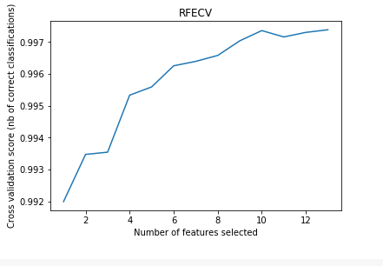
Parameter Optimization
It is a process of choosing optimal parameter for learning algorithms. This measure is known as hyperparameter and resultant model solve problem optimally.
RFECV to test problem optimization.

Slide 17
Classification
Classification is a process of arrangement of optimized parameters so that useful information can extract in data.
Random Forest is the method to solve the problem to avoid over fit of data in decision tree

Slide 18
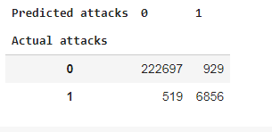
Evaluation
Model will be evaluated on the bases of confusion matrix. Multiple scores are measured such as:
Accuracy,
Precision
Recall
F-measure
F-measure by performance of 10-fold cross-validation.

Slide 19
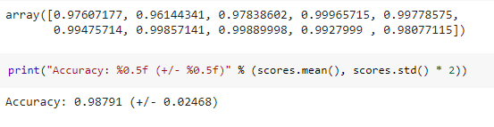
Cross validation
Cross validation is 10 folds

Slide 20
conclusion
IDS is todays want because, it helps the people to stay up their confidentiality and integrity. Intrusion that disturbs the safety and secrecy of the system, has become chief concern for several organizations
Security is always important

Slide 21
Thank You

Slide 22
Q & a

